Slide 1
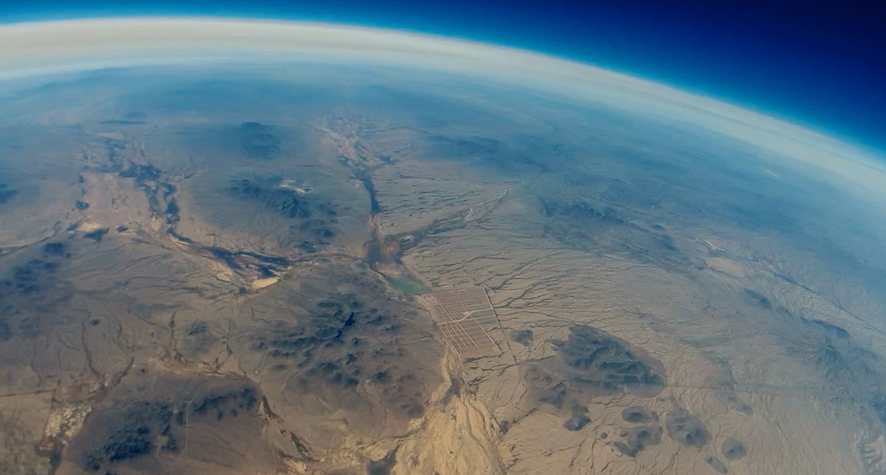





PHOENIX COLLEGE
NASA ASCEND SYMPOSIUM PRESENTATION
2018-2019

Slide 2
Team Members
Eunice Lopez
Ivan Martinez
Jessica Frantz
Chris Yurgel
Modesta Juarez
Isai Uriarte*
Brian Moreno*
Jackie Salazar
*Volunteers

Slide 3
2018-2019 Main Goals
Livestream
In-flight Video
Build Protective Lightweight Housing
Gather Atmospheric Data

Slide 4






Video System
APRS Packet
APRS Server
Payload
Livestream!
Video Transmission
Rotor
Controller Software
Rotor System
Video Transmission Software

Slide 5
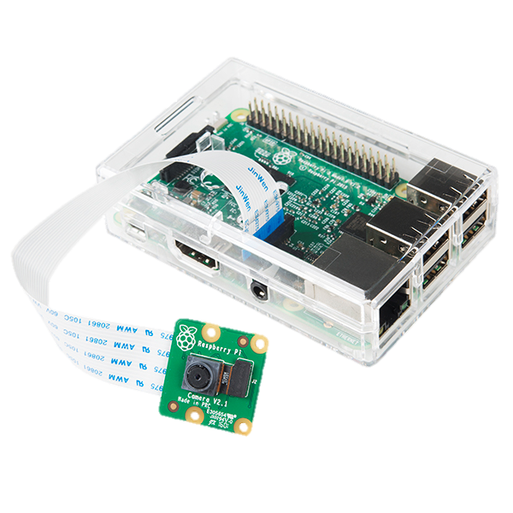
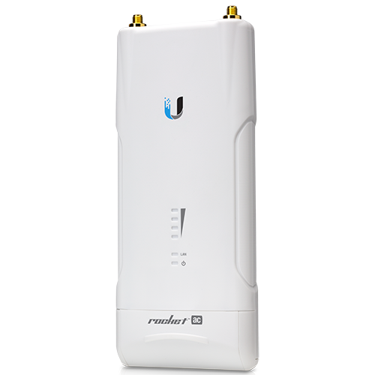
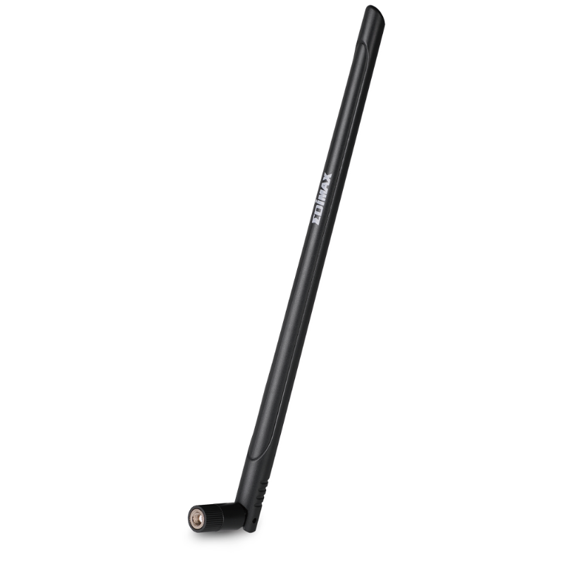
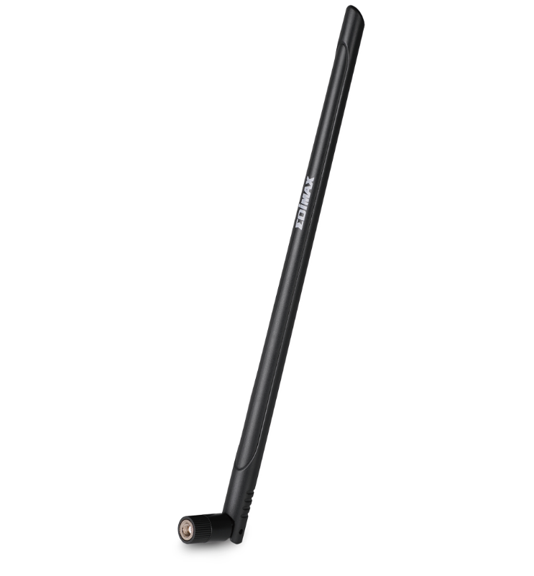
Video System on Payload
  Hardware
  Raspberry Pi Camera
  Raspberry Pi
  Ubiquiti Rocket M5AC Wireless Transceiver
  5.8GHz Dipole Wi-Fi Antennas
  Software
  Linux
  FFmpeg

Slide 6
Video Processing on Payload
Raspberry Pi
• Linux OS
• Video Processing
Raspberry Pi Cam
• 720ppi
• 24FPS
Rocket M5
• Ubiquiti Air Os
• Video Transmission

Slide 7
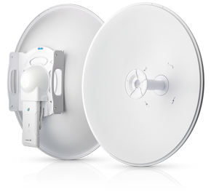
Ground Station Video System
  Hardware
  Ubiquiti Rocket M5AC Wireless Transceiver
  Ubiquiti 5.8GHz Rocketdish-LW Series Dish Antenna
  Software
  VLC Player
  OBS Screen Capture

Slide 8
Video Processing on Ground Station
Rocket M5
• Ubiquiti Air Os
• Video Reception
Video Processing
• VLC
• OBS
YouTube
• Livestream video
RocketDish
• 30dBi

Slide 9
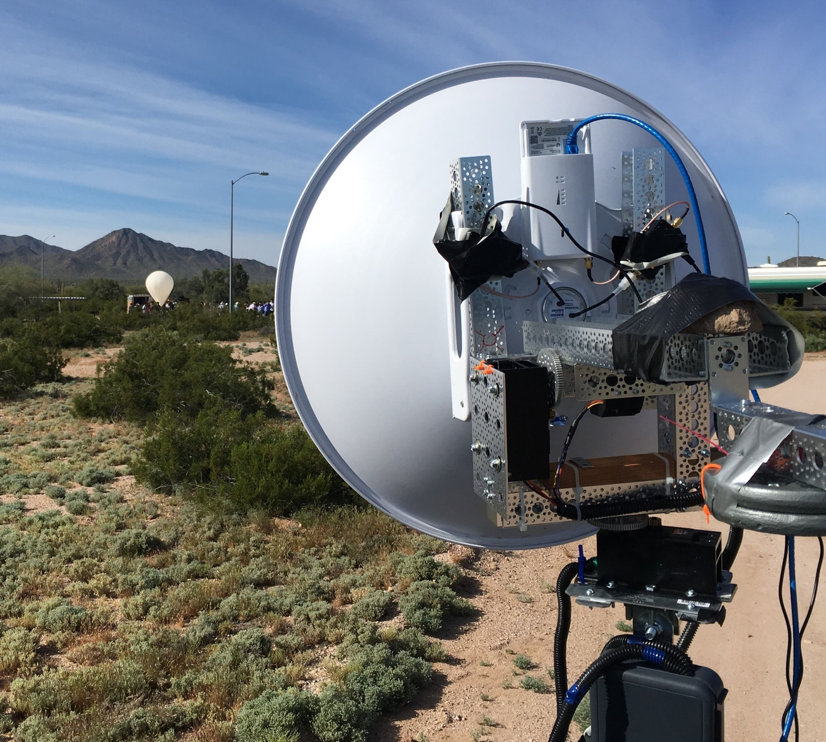
Ground Station Tracking System
  Hardware
  Ubiquiti Rocket M5AC Wireless Transceiver
  LSM303 for heading
  9-DoF for elevation
  BU-353S4 GPS
  HS-805MG 5:1 Servo gearboxes
  Software
  Arduino
  Python

Slide 10
Ground Station Tracking System
Arduino
• Ground station position data processing
• Data comparison and feedback
Servos
• Antenna positioning
APRS Server
• Automatic packet reporting system data from the payload
GPS
• Ground station coordinates
Python Scripts
• Location data processing

Slide 11
Video System Results
  Achieved a video connection for 20.8 miles
  Achieved a data connection for 21.5 miles
  Slight delay in video stream
  Successfully rotated our dish antenna based on APRS packets (Fall 2018)
  Managed to control our dish antenna based on manually inputted coordinates determined from APRS packets (Spring 2019)

Slide 12
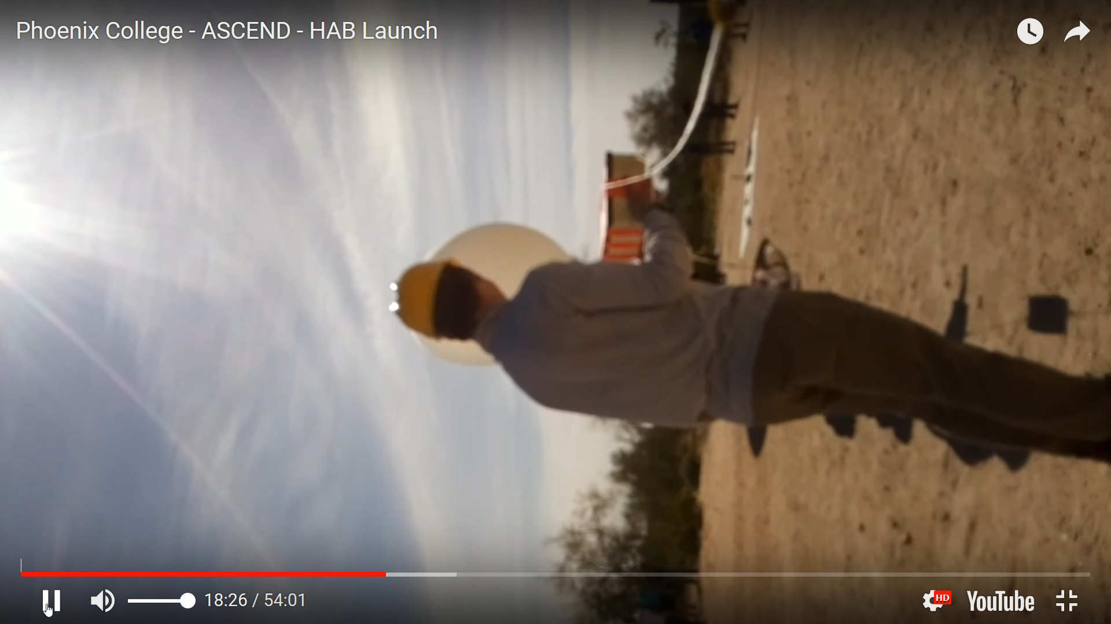

Slide 13
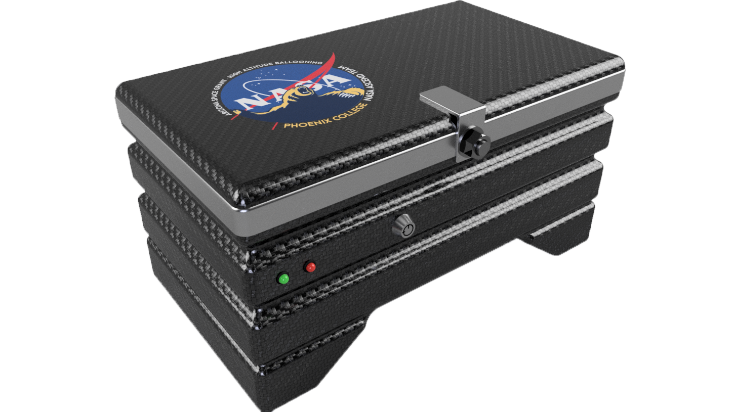
Housing and Suspension
Lightweight carbon fiber housing protects electronic components and allows secure mounting
Kevlar cord suspension method reduces weight
Ease of access to on/off switch and LED power indicators

Slide 14

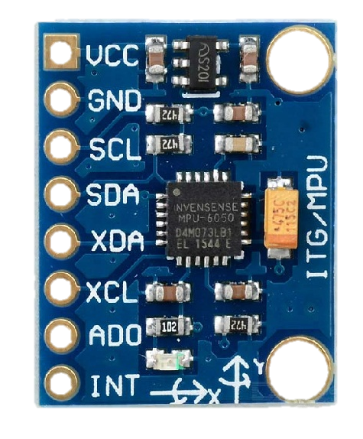
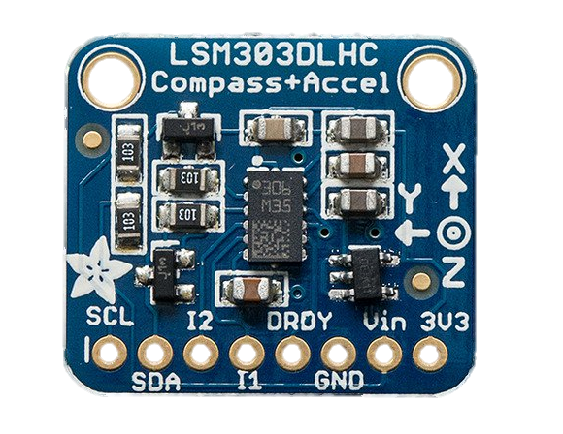
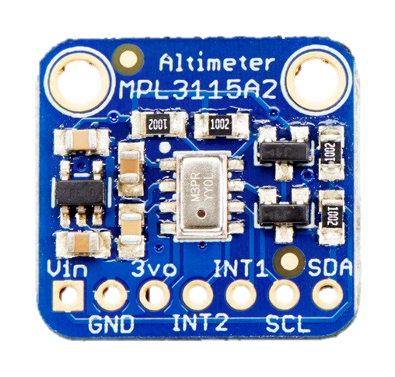
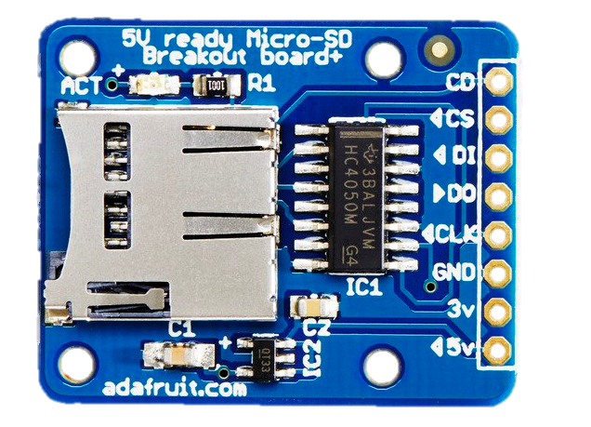
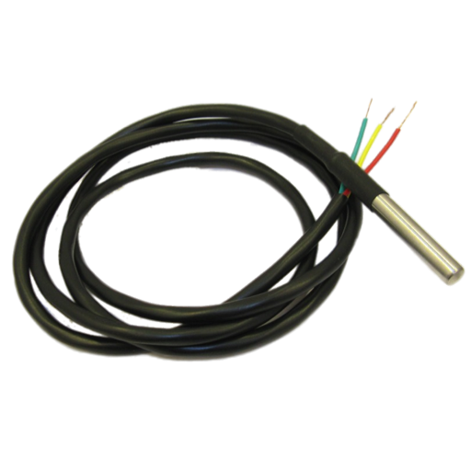
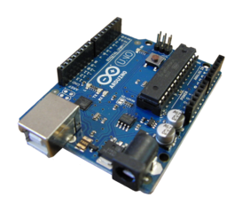
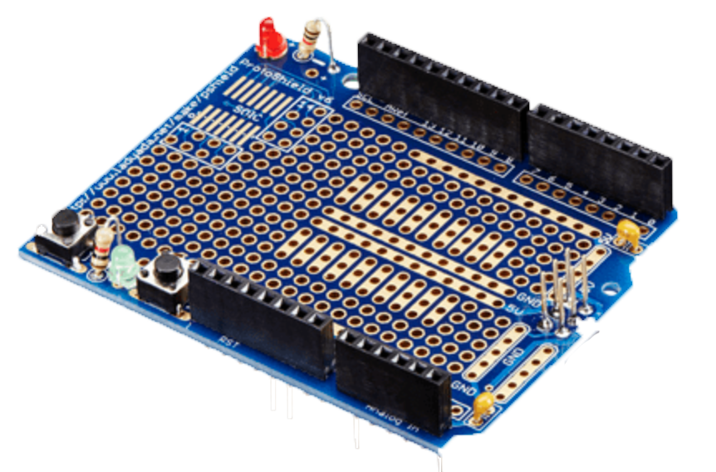
Atmospheric Profiling System
External temperature sensor – DS18B20
Orientation sensors – MPU6050 and LSM303
Barometer – MPL3115A2
MicroSD card breakout board
Arduino prototype shield
Arduino Uno

Slide 15
Atmospheric Profiling System
Based on the logged data, we were able to determine loss of power when our payload reached minimum temperatures.
Power resumed during descent

Slide 16
Power and Data Distribution Board
Lightweight power solution for all subsystems
Reduced points of failure by eliminating unnecessary components and wiring
Includes data transfer line from raspberry pi to Ubiquiti modem.
Primary components:
7.4V LiPo Battery
Buck/Boost for 5V line
Step-Up voltage regulator for 12V line
7.4V
Atmospheric Transmission System
5V
12V
Raspberry Pi
RJ45
RJ45
Raspberry Pi
Data
Ubiquiti
Modem

Slide 17
Thank you!
Special Acknowledgements:
Arizona Space Grant Consortium
Arizona Near Space Research
Ernest Villicaña (Faculty Mentor)
Dr. Ed Ong (Science Advisor)

